Slide 1
The College Path
A Middle School Student’s Guide

Slide 2
WHAT DOES THAT MEAN?
TERM
MEANING
COMMUNITY COLLEGE
ASSOCIATE OF ARTS (or SCIENCE) DEGREE
CAREER TECHNICAL EDUCATION (CTE)
CERTIFICATE
APPRENTICESHIP
LICENSE
CONSERVATORY
UNITED STATES MILITARY
ENLIST
ASVAB=ARMED SERVICES VOCATIONAL APTITUDE BATTERY
A community college is a two-year college attracting g students from the local community.
A.A. or A.S. degree is awarded for completion of studies at a community college.
College certificate programs offer you an alternative academic credential to the lengthier undergraduate or graduate degree programs. The coursework of such programs tends to be compressed, focusing almost entirely on a specific topic.
Apprenticeship Programs teach a worker the skills and knowledge needed to perform duties in a chosen occupation through on-the-job and classroom training.
When it comes to higher education, prospective music and theater arts majors may opt to attend a conservatory.

Slide 3
COLLEGE: What’s in it for you?
WHAT DOES THAT MEAN?
COLLEGE
UNIVERSITY
MULTIPLE (INTERNAL) ACADEMIC DIVISIONS
SYSTEM OF UNIVERSITIES
POSTSECONDARY EDUCATION
A college or university is an institution of higher learning-a school. There are some differences between a college and university. A university can be larger than a college, is divided into academic divisions known as “colleges,” and can be one of several in a system of universities. But, academically they are very similar. A postsecondary education is learning after high school

Slide 4
WHAT ARE THE BENEFITS OF A COLLEGE EDUCATION?
FOUR YEAR TERM
BENEFITS OF A COLLEGE EDUCATION:
SHOW ME THE MONEY!
College graduates make much more money than high school graduates.
WHO’S THE BOSS?
College graduates get better jobs, and have more opportunities for career advancement.
UNEMPLOYMENT S*CKS!
College graduates have lower unemployment rates.
COLLEGE IS COOL!
College is fun.
SELF-IMPROVEMENT IS A LIFELONG PURSUIT.
College inspires in many people a lifelong pursuit of intellectual growth and self-improvement, which can lead to a better life.

Slide 5
SUM IT UP
The quality of your life as an adult is directly linked to the education you get after high school. Everyone needs more than a high school education. Money, career advancement, greater job security, fun, friends, a stronger nation and, ultimately, a fuller, richer life, are just a few of the benefits of a college education.
GET ON THE COLLEGE PATH!

Slide 6
I SPY A.....COLLEGE CAMPUS!

Slide 7
WHAT DOES THAT MEAN?
TERM
MEANING
UNDERGRADUATES
STUDENT BODY
ASSISTANT PROFESSOR
ASSOCIATE PROFESSOR
TENURED PROFESSOR
PROFESSOR EMERITUS
TEACHING ASSISTANT (T.A.)
FACULTY
Undergraduates are students at a four-year college or university.
The student body refers to the entire population of undergraduates at a college or university.
A professor is a teacher in college.
An assistant professor is an introductory level professor.
An associate professor is a mid-level professor.
A tenured professor is a senior professor with a lifetime appointment to teach at the college or university.
A T.A. is a student who assists the professor with instructional responsibilities.
Collectively, the professors are referred to as the faculty.

Slide 8
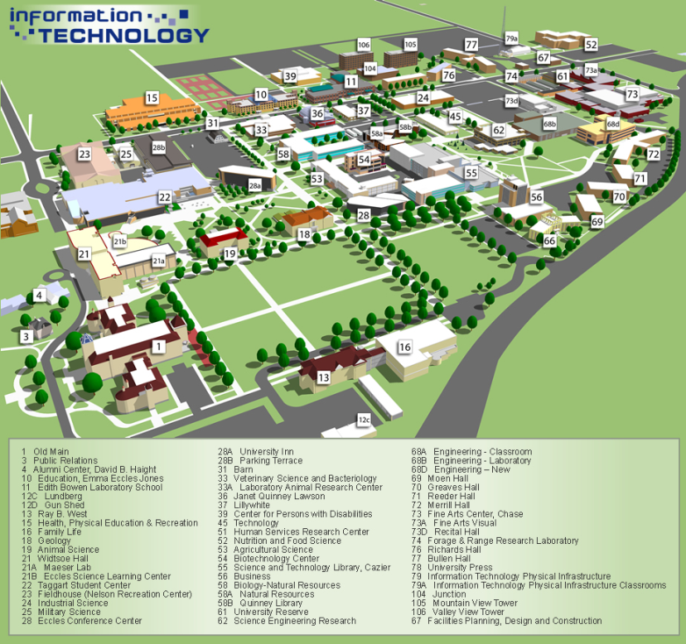
WHAT’S A COLLEGE CAMPUS LIKE?
College Campus
Library, lecture halls, classrooms, science labs, theater
Student body, professors, dining commons, cafes/coffee bars
Residence hall, COED, theme, learning community
Bookstore
Student Health Center
Quad
Athletic Center, football stadium
Student Union

Slide 9
SUM IT UP
College campuses are busy, exciting places. Even though colleges may look different, they have certain buildings and features in common. Imagine yourself as a student on a college campus!

Slide 10
LET’S GO TO COLLEGE!

Slide 11
WHAT DOES THAT MEAN?
TERM
MEANING
Region
Academic/selective
Settings
Size
Personalities
Affiliation
G.P.A. (Grade Point Average)
A region is the U.S. Dept. of Education’s geographic divisions of colleges.
Academic / selective denotes the level of scholarly studies.
The setting is a college’s location and surroundings.
The size is determined by the number of undergraduates enrolled at the college.
Personality is the “vibe” ones gets from the campus.
Affiliation refers to a college that was started by or for the purpose of educating a particular group of people, or is associated with a group of colleges promoting educational opportunities for a group of people.
G.P.A.; the conversion of a student’s letter grades into a numerical equivalent used to compare students’ academic abilities.

Slide 12
WITH SO MANY CHOICES, HOW DO STUDENTS DECIDE WHICH COLLEGE TO GO TO?
Region: Far West, Southeast, Rocky Mountains, Great Lakes, Southwest, Mideast, Plains, and New England
Academics: Highly Selective=Highly Academic; Ivy League. G.P.A. should be very high
Setting: Urban, Large city/metropolitan, Rural, Small town, Coastal, Mountains, Plains.....
Size: Small=5000 or less; Medium=5000 -10,000; Large=10,000 or more!
Personality /VIBE: Coeducational (COED); Architectural Style; Interests of Students; The Feel of the Campus.

Slide 13
SUM IT UP
Many factors go into a student’s choice of college. You have just learned the six most important selection criteria: region, academics, setting, size, personality, and affiliation. Colleges, like students, come in all shapes and sizes. With so many choices in the U.S., there is a good college fit for every student!

Slide 14
ROAD TRIP

Slide 15
WHAT DOES THAT MEAN?
TERM
MEANING
LIBERAL ARTS COLLEGE
DEGREE
BACHELOR’S DEGREE
BACHELOR OF ARTS DEGREE (B.A.)
BACHELOR OF SCIENCE DEGREE (B.S.)
A Liberal Arts College offers a general, well-rounded curriculum, rather than a focus on a particular career or skill.
A degree is a reward given to a student for successfully completing college.
A Bachelor’s Degree is awarded by four-year colleges and universities.
B.A. Degree; is a degree earned by students who complete studies dedicated to the arts.
B.S. Degree; is a degree earned by students who focus on science related classes.

Slide 16
LET’S HIT THE ROAD!
ROAD TRIP TOUR CARD
BEGIN THE ROAD TRIP!
CONSIDER: REGION, SETTING (FOUR YEAR COMMITMENT), SIZE (SM, M, L?), ACADEMICS (SELECTIVITY), AFFILIATION, VIBE (DO YOU LIKE THE LOOK? DO YOU LIKE THE STUDENTS?
CAN YOU SEE YOURSELF AS AN UNDERGRADUATE AT COLLEGE?

Slide 17
SUM IT UP
There is an amazing diversity of college experiences available in the U.S.-small, large, public, private, in any and all settings and regions! Use college selection criteria (region, setting, size, academics, vibe and affiliation) to compare colleges, formulate impressions of colleges and to find a good match for your academic talents and educational goals.

Slide 18
LET’S APPLY TO COLLEGE!

Slide 19
WHAT DOES THAT MEAN?
TERM
MEANING
APPLICATION FOR UNDERGRADUATE ADMISSION
COLLEGE APPLICATION
ACADEMIC ACTIVITIES
EXTRACURRICULAR ACTIVITIES
PERSONAL STATEMENT ESSAY
TRANSCRIPT
LETTER OF RECOMMENDATION
ADMISSIONS COMMITTEE
ACCEPTS
STATEMENT OF INTENT TO REGISTER
STATEMENT OF INTENT TO ENROLL
A college application is an application for Undergraduate Admission.
Academic activities involve activities within the classroom.
Extracurricular activities are held outside the classroom.
A transcript is an official list of a student’s grades.
An interview is the part of the college application process that involves a meeting with a representative of the college to discuss admission, campus life and student’s goals.
A recommendation letter is a letter from a teacher, counselor or other adult vouching for a student’s good character, academic ability and integrity.
The admissions committee is a group of people at the college who review a student’s college application to determine if the college and the student are a good match; notice to student that he/she has been accepted for admission as an undergraduate at the college.
A statement of intent to register/enroll is a document by which a student accepts an offer of admission.

Slide 20
APPLICATION FOR UNDERGRADUATE ADMISSION
COMPLETED AND SUBMITTED ONLINE
COLLEGE APPLICATION SEASON IS GENERALLY FALL OF SENIOR YEAR
COMMON APP=400+ COLLEGES
ABSOLUTE DEADLINE
EARLY DECISION

Slide 21
THE APPLICATION PROCESS
ACTIVITIES (ACADEMIC AND EXTRACURRICULAR)
TRANSCRIPT AND TEST SCORES
PERSONAL STATEMENT ESSAY
LETTER OF RECOMMENDATION
INTERVIEW (REQUIRED BY MOST COLLEGES; GIVES ADMISSIONS COMMITTEE A BETTER SENSE OF A STUDENT’S UNIQUE TALENTS, EXPERIENCES, AND LIFE GOALS)
SPELLING, PUNCTUATION, AND GRAMMAR ARE IMPORTANT

Slide 22
THE PERSONAL STATEMENT ESSAY
REQUIRED BY MOST COLLEGES
GIVES ADMISSIONS COMMITTEE A BETTER SENSE OF A STUDENT’S UNIQUE TALENTS, EXPERIENCES, AND LIFE GOALS
SPELLING, PUNCTUATION, AND GRAMMAR ARE IMPORTANT

Slide 23
SUM IT UP
Having a basic understanding of the college application process will help you navigate the college path in high school. A college application is more than filling out a form! There are many different aspects to an application. In high school, get involved in meaningful extracurricular activities and community service; maintain a good GPA all four years. Develop leadership skills, and always maintain a high level of personal and academic integrity. These things will be important when you apply to college.

Slide 24
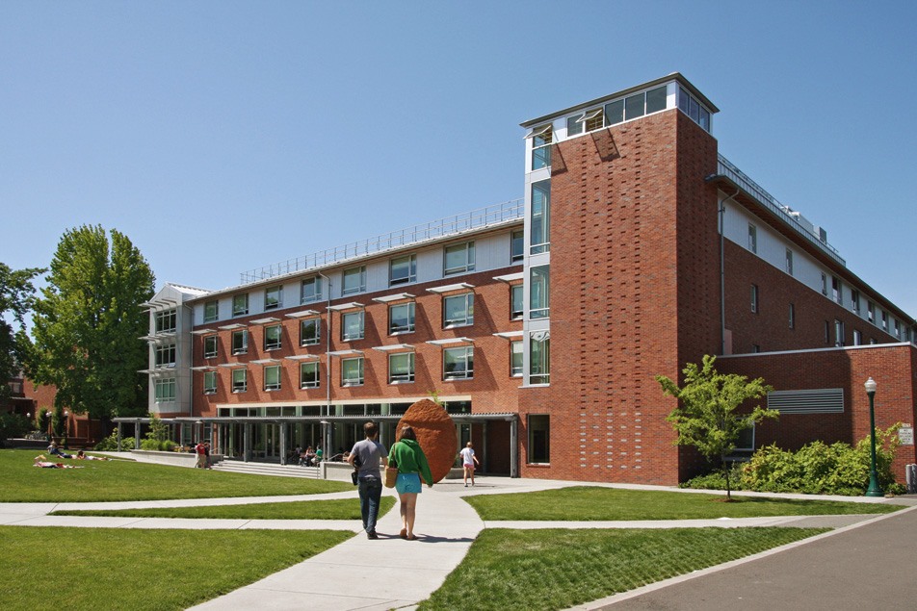
MOVE – IN DAY

Slide 25
WHAT DOES THAT MEAN?
TERM
MEANING
MOVE-IN DAY
PERSONAL INFORMATION SURVEY
RESIDENT ASSISTANT (R.A.)
FRESHMAN
SOPHOMORE
JUNIOR
SENIOR
ROOMMATE CONTRACT
DEAN
Move-in day is the day students arrive at college to move into their residence hall, and meet incoming freshman.
The personal information survey is a series of questions about a student’s lifestyle designed to enable a college housing office to make a successful roommate match.
An R.A. is an older student who supervises the residence hall and acts as a peer counselor, advisor and friend to new students.
A roommate contract is a written agreement between roommates addressing rules and guidelines for living together, avoiding and resolving conflict.
A freshman is a student in his/her first year of college.
A sophomore is a second year student.
A junior is a student in the third year of college.
A senior is a student in their fourth or last year of college.
The Dean is an administrative officer in charge of a college, faculty, or division in a university.

Slide 26
MOVE-IN DAY
FIRST DAY-STUDENTS ARRIVE ON CAMPUS-NO CLASS
RESIDENT ASSISTANT (R.A.)
FLOORS OR WINGS
COMMON AREA

Slide 27
DORM ROOMS AND ROOMMATES
DORM ROOMS ARE GENERALLY 10X10 BASIC LIVING QUARTERS
SINGLES, DOUBLES, TRIPLES, AND SUITES
ROOMMATES SAME GENDER
GENERALLY COMPATIBLE
PERSONAL INFORMATION SURVEY INVESTIGATES COMPATIBILTY INDICATORS LIKE TOLERANCE FOR MESS, SLEEPING HABITS, AND MUSIC PREFERENCES

Slide 28
RESOLVING ROOMMATE CONFLICT
COMMUNICATION IS KEY
ROOMMATE CONTRACT FOR LIVING CONDITIONS AND CONFLICT RESOLUTION
PEER MEDIATION
ROOM CHANGE

Slide 29
SUM IT UP
Move-In Day is an exciting day for a college freshman. Students arrive on campus, meet roommates and say goodbye to family and friends who helped them move to college. Dorm floors and wings function as a student’s immediate community. Most roommates are compatible, but in the event of conflict, a roommate contract or resident assistant may be needed.

Slide 30
MAJOR DISCOVERY!

Slide 31
WHAT DOES THAT MEAN?
TERM
MEANING
MAJOR
CORE COURSE
FRESHMAN CORE
MAJOR CORE
ELECTIVE
ACADEMIC ADVISOR
SEMESTER/QUARTER
COLLEGE OF THE ARTS
COLLEGE OF THE SCIENCES
A major is the subject or field of study chosen by a student to study in college.
Core courses are general education classes required of all undergraduates, regardless of their major.
Freshman core classes are required specifically of all freshmen.
Major core classes are classes that students are required to take within their major.
An elective is a class taken for credit based on personal interest.
An Academic Advisor is the person at the college who helps the student select courses, and guides him/her to completion of their major.
Semesters are part of a system used to divide the academic year into two terms of relatively equal length.
Quarters are part of a system used to divide the academic year into four terms of relatively equal length.
A College of the Sciences is a division of a college or university supervising majors leading to a B.S. degree.
A College of the Arts is a division of a college or university supervising majors leading to a B.A. degree.

Slide 32
MAJOR DISCOVERY!
COLLEGE STUENTS HAVE A GREAT DEAL OF ACADEMIC FREEDOM TO STUDY SUBJECTS OF INTEREST TO THEM.
MAJOR DISCOVERY #1: SOCIAL SCIENCES INCLUDES ARCHEOLOGY, CRIMINOLOGY, ECONOMICS, AND MANY MORE GREAT SUBJECTS.
MAJOR DISCOVERY #2: SCIENCE INCLUDES OCEANOGRAPHY, MARINE SCIENCE, METEOROLOGY, ETC.
MAJOR DISCOVERY #3: ART INCLUDES ART HISTORY AND RESTORATION, FILM STUDIES, ANIMATION.....
MAJOR DISCOVERY #4: SPORTS INCLUDES MANAGEMENT, FITNESS, JOURNALISM AND MORE!
MAJOR DISCOVERY #5: MUSIC INCLUDES MUSIC HISTORY, ACOUSTICS, RECORDING TECHNOLOGY, ELECTRONIC MUSIC, 3D ANS SPACIAL SOUND, AND THE MUSIC BUSINESS!

Slide 33
SUM IT UP
In college, students enjoy a great deal of academic freedom. Students declare a major which allows them to pursue and study, in depth, subjects of personal interest. There is an awesome variety of exciting majors. Regardless of what you study, it’s the college education that counts!

Slide 34
It’s On! COLLEGE SPORTS

Slide 35
WHAT DOES THAT MEAN?
TERM
MEANING
NATIONAL COLLEGIATE ATHLETIC ASSOCIATION (NCAA)
DIVISIONS
CONFERENCES
INTERCOLLEGIATE VS. INTRAMURAL
RECRUITING REGULATIONS
ACADEMIC ELIGIBILITY RULES
TITLE XI
REDSHIRT
WALK-ON
National Collegiate Athletic Association; the body that governs U.S. men’s and women’s college sports.
For competition, the NCAA divides colleges into three divisions.
The NCAA divisions are grouped by conferences for competition.
Intercollegiate sports are competitive and take place between different colleges in the same NCAA division.
Recruiting regulations are rules that govern the contact of prospective student-athletes and college coaches must follow in order for the student to be eligible to play for the college.
Intramural sports are competitive but recreational on-campus events; often accommodating many skill levels from beginner to advanced.
Title IX is the federal law requiring women be provided with an equal opportunity in sports and academics.
A redshirt athlete is a college student-athlete withheld by the coach from competition for an academic year, often to extend the athlete’s NCAA four-year eligibility period.
Eligibility rules are NCAA rules requiring a student-athlete to meet certain GPA, test score, and course requirements to play intercollegiate sports.
A walk-on is an athlete who becomes part of the college team without being recruited.

Slide 36
COLLEGE SPORTS
INTERCOLLEGIATE VS INTRAMURAL
ABOUT 40 OFFICIALLY RECOGNIZED COLLEGE SPORTS
NCAA SETS RULES AND GUIDELINES FOR MOST, BUT NOT ALL, COLLEGE SPORTS
COLLEGE OR UNIVERSITY WILL PLAY AN AVERAGE OF 20 MEN’S AND WOMEN’S SPORTS

Slide 37
NCAA DIVISIONS
DIVISIONS – NCAA DIVIDES COLLEGE SPORTS INTO THREE INTERCOLLEGIATE DIVISIONS:
DIVISION I: THE HIGHEST LEVEL OF INTERCOLLEGEIATE ATHLETICS
DIVISION II: INTERMEDIATE-LEVEL, BUT ALSO HIGHLY COMPETITIVE
DIVISION III: SMALLER IN SIZE SCHOOLS, AND PLACE A HIGH PRIORITY ON THE OVERALL EDUCATION EXPERIENCE OF THE STUDENT-ATHLETE
CONFERENCES AND LEAGUES
TITLE XI- (1972) BANNED SEX DISCRIMINATION IN ACADEMICS AND ATHLETICS

Slide 38
SO YOU WANT TO PLAY INTERCOLLEGIATE SPORTS?
MAKE CONTACT
STUDY HARD
BE ACADEMICALLY ELIGIBLE
DO YOUR RECRUITMENT RESEARCH
WALK-ON (RARE ON A D-1 TEAM)
REDSHIRT-EXTENDS NCAA COMPETITION ELIGIBILITY FOR AN ADDITIONAL YEAR

Slide 39
SUM IT UP
Sports are an exciting part of college life. And an important American tradition. A variety of sports are offered at D-I, D-II, and D-III colleges to both men and women. To play intercollegiate sports, it is important to work hard at your sport and your grades! Know the NCAA rules of academic eligibility and what you need to do to get recruited.

Slide 40
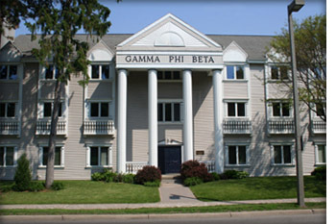
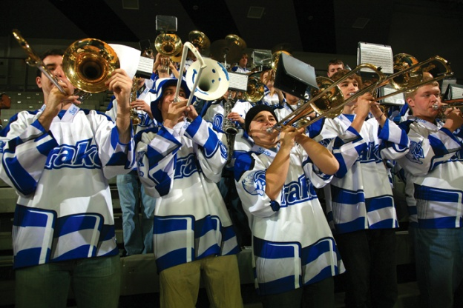
OPPORTUNITIES UNLIMITED!

Slide 41
WHAT DOES THAT MEAN?
TERM
MEANING
STUDENT ORGANIZATIONS
INTERNSHIP
STUDY ABROAD
RUSH
THE GREEK SYSTEM
FRATERNITY
SORORITY
Student organizations are student-run bodies offering extracurricular academic, political, cultural, recreational, spiritual, service and social opportunities for college students.
An internship is a learning opportunity providing a student with a short, real world experience in their field of study.
Studying abroad gives the student an opportunity to complete part of their major in another country.
The Greek system is a college tradition of groups of men and women who join together to form a fraternity or sorority to offer social and academic support and activities. Some have affiliations to attract and support people of a particular race or culture.
The term “Rush” means a student organization ‘s campus campaign to recruit new members .

Slide 42
WHAT ARE STUDENT ORGANIZATIONS?
ACADEMIC
POLITICAL
RECREATIONAL
CULTURAL
SPIRITUAL
SERVICE
SOCIAL

Slide 43
WHAT ARE INTERNSHIPS?
REAL WORLD EXPERIENCE IN FIELD OR MAJOR
PRIVATE COMPANY, GOVERNMENT AGENCY, EVEN PROFESSIONAL SPORTS TEAMS
PAID OR UNPAID
TERM: SUMMER, SEMESTER, OR ENTIRE YEAR
CAN BE VERY COMPETITIVE
ROTC: LIKE A MILITARY INTERNSHIP

Slide 44
WHAT IS STUDY ABROARD?
STUDY ABROAD ALLOWS A STUDENT TO COMPLETE PART OF THEIR MAJOR, UPPER DIVISION COURSES OVERSEAS
VERY POPULAR WITH COLLEGE STUDENTS
STUDENT LIVES ON CAMPUS OR WITH HOST FAMILY

Slide 45
SUM IT UP
College is about much, much more than studying and taking classes. Student organizations, internships and study abroad offer unlimited opportunities for activity, adventure and personal growth in college. When you get to college, join a club, or participate in an internship or study abroad, to make the most of your college experience.

Slide 46
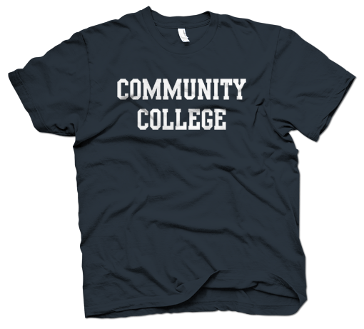
ALTERNATIVE PATHS TO SUCCESS!

Slide 47
WHAT DOES THAT MEAN?
MEANING
TERM
COMMUNITY COLLEGE
ASSOCIATE OF ARTS (A.A) DEGREE
CAREER TECHNICAL EDUCATION (CTE)
CERTIFICATE
APPRENTICESHIP
LICENSE
CONSERVATORY
UNITED STATES MILITARY
ENLIST
ASVAB=ARMED SERVICES VOCATIONAL APTITUDE BATTERY
A community college is a two-year college attracting students from the local community.
A.A. degree is awarded for completion of studies at a community college.
CTE teaches practical skills related to a specific job, field or career; includes maritime academy to train for sea-based careers.
An apprenticeship is a paid on-the-job training, often supplemented with classroom instruction.
A certificate is a document awarded to a CTE trainee, certifying that he/she has successfully completed specific training or passed a qualifying test.
A license is official authorization from a governmental agency to engage in a particular trade.
The U.S. military is made up of the Army, Air Force, Coast Guard, Marine Corps, and the Navy.
To enlist means to join a branch of the U.S. military.
Armed Services Vocational Aptitude Battery; a test which must be taken in order to enlist in the U.S, military.

Slide 48
ALTERNATIVE PATHS TO SUCCESS
COMMUNITY COLLEGE
CAREER TECHNICAL EDUCATION (CTE)
FINE ARTS CONSERVATORY
UNITED STATES MILITARY

Slide 49
COMMUNITY COLLEGE
COMMUNITY COLLEGE EDUCATION GOALS
GENERAL EDUCATION
TRANSFER EDUCATION (CAUTION! MAKE SURE YOU’RE COMMITTED TO YOUR TRANSFER PLAN)
CAREER EDUCATION: CERTIFICATE, LICENSE, A.A. DEGREE
REMEDIAL EDUCATION

Slide 50
CT EDUCATION & CONSERVATORY
CAREER/TECHNICAL SCHOOL (CTE) (AKA VOCATIONAL EDUCATION (VOC-ED) AND TRADE SCHOOL)
TEACHES CAREER SKILLS
STUDENTS EARN CERTIFICATES OR LICENSE
PROGRAMS OFTEN LESS THAN 2 YEARS
MARITIME ACADEMIES (STUDENTS CAN EARN B.S. DEGREE, AND PROGRAMS CAN BE 4 YEARS)
IMMERSES STUDENT IN THE STUDY OF A FINE ART
2-5 YEAR PROGRAMS
COMPETITIVE: AUDITION REQUIRED FOR ADMISSION

Slide 51
THE UNITED STATES MILITARY
A CANDIDATE MUST BE 17 (WITH PARENTAL PERMISSION) OR 18 TO ENLIST AND BE A HIGH SCHOOL GRADUATE. BRANCHES:
ARMY
AIR FORCE
MARINE CORP (“OOH-RAH!”)
NAVY
COAST GUARD
“ASVB”-THE CANDIDATE MUST TAKE AND PASS THE ARMED SERVICES VOCATIONAL APTITUDE BATTERY

Slide 52
SUM IT UP
A traditional four year college may not be the ideal postsecondary fit for all students. There are many excellent alternative paths to success. No matter what your postsecondary plans are, work hard at college preparation, to assure that you are well-qualified for any postsecondary educational opportunity!

Slide 53
THE COLLEGE INVESTMENT

Slide 54
INVESTMENT
[in-vest-muhnt] (n): the act of putting money in, or devoting time, talent or emotional energy for profit or gain.
HOW IS COLLEGE AN INVESTMENT?

Slide 55
WHAT DOES THAT MEAN?
TERM
MEANING
TUITION
ROOM AND BOARD
FINANCIAL AID
STUDENT LOAN
SCHOLARSHIP
GRANT
PELL GRANT
NEED-BASED
MERIT-BASED
Tuition is a fee for instruction.
Room and Board is lodging in the residence hall and meals at the dining commons.
Financial aid is money loaned or given to a student to help them pay tuition, room and board, books, fees and supplies; loans, scholarships, grants, and work-study are types of financial aid.
Scholarships/Grants whether need-based or merit based are types of financial aid awarded to a student, for the purpose of paying for college; a need-based scholarship or grant is an award of money based on a student’s financial need; an award of money based on a student’s achievement or leadership skills or athletic skill is a merit-based scholarship or grant. There are private scholarships and grants based on talent, interest, ethnic heritage or membership. Grants and scholarships do not have to be paid back.
A student loan is a U.S. federal government subsidized (supported ) loan of funds to students for the purpose of paying for the costs of attending college.
A Pell Grant is an award of money from the U.S. federal government to low income students to help pay for college.

Slide 56
HOW DO STUDENTS PAY FOR THEIR COLLEGE INVESTMENT?
COLLEGE $AVING$
FINANCIAL AID (FAFSA)
STUDENT LOANS
SCHOLARSHIPS/GRANTS ARE:
NEED-BASED (PELL GRANT)
ACADEMIC MERIT-BASED
ATHLETIC MERIT-BASED (D-1 AND D-2)
WORK STUDY

Slide 57
WHAT ARE PROFILE/PRIVATE SCHOLARSHIPS? WHAT IS AN ROTC SCHOLARSHIP
PRIVATE COMPANIES AND CIVIC ORGANIZATIONS MAY OFFER SCHOLARSHIPS AND GRANTS TO STUDENTS BASED ON MEMBERSHIP, INTEREST, TALENT OR AFFILIATION.
THE ROTC OFFERS SCHOLARSHIPS IN EXCHANGE FOR LEARNING MILITARY MANAGEMENT SKILLS WHILE IN COLLEGE, AND MILITARY SERVICE AFTER GRADUATION.

Slide 58
SUM IT UP
A college investment is an excellent investment in yourself. Don’t let limited financial resources discourage your college dreams. Almost every college student qualifies for some form of financial aid. There are many sources of financial assistance for a college bound student. Work hard to improve your college scholarship profile!

Slide 59
DISASTER ON THE PATH!

Slide 60
WHAT DOES THAT MEAN?
TERM
MEANING
DEAN’S LIST
FRESHMAN SEMINAR
ACADEMIC PROBATION
PASS/FAIL
The Dean’s list is a category of college students who achieve high grades during an academic term; equivalent to an honor roll.
Freshman Seminar is a small-group course designed to actively involve freshmen in the process of exploring a thought-provoking topic.
Academic probation is when a student’s GPA has fallen below a college’s minimum GPA level.
Pass/Fail is a grading system in which a student receives a “pass” or “Fail” rather than a numerical or letter grade.

Slide 61
FOR A SUCCESSFUL JOURNEY ON THE COLLEGE PATH, ELIMINATE POOR ACADEMIC WORK HABITS, TIME MANAGEMNET AND ORGANIZATIONAL SKILLS! ADOPT HABITS AND PRACTICES THAT SUPPORT COLLEGE PATH GOALS. DUE DATES, DEADLINES AND DIRECTIONS ARE IMPORTANT! SMALL ERRORS CAN HAVE A BIG IMPACT ON YOUR GRADE. LEARN COLLEGE-READY RESEARCH SKILLS.

Slide 62
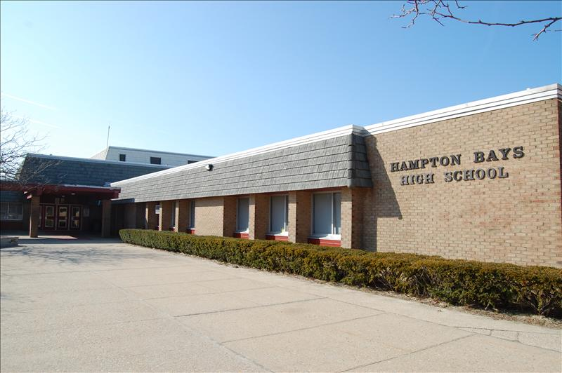
THE HIGH SCHOOL YEARS

Slide 63
Q. You have been invited to a friend’s house. The friend lives about 100 miles away. You have never been to their house. You have never even been to their town. Your mom, dad, or other adult has agreed to drive you there, but you are responsible for finding the way. What should you do?
Convince your mom, dad, or other adult that finding the friend’s house is the driver’s responsibility.
Hop in the car, head in the general direction of your friend’s town and hope for the best.
Have a plan, know where you’re going; know the friend’s address, have a map, use directions/GPS navigator....
Stay home.

Slide 64
WHAT DOES THAT MEAN?
TERM
MEANING
ADVANCED PLACEMENT (AP)
INTERNATIONAL BACCALAUREATE (IB)
ACT
SAT
COLLEGE ADMISSIONS TESTS
PRELIMINARY SAT (PSAT)
PLAN
ADMISSION REQUIREMENTS
Advanced placement & International baccalaureate courses are high school courses equivalent to undergraduate courses in college.
The ACT is a college admission test.
The SAT is a standardized test taken in high school to provide practice and information about a student’s academic strengths and weaknesses.
Plan on taking academically challenging course s in high school.
Admission requirements are the academic preparation and profile required by a college for a student to be qualified for admission.

Slide 65
THE COLLEGE PATH PREVIEW: THE HIGH SCHOOL YEARS
GET TO KNOW YOUR COUNSELOR!
MAP YOUR PATH!
GPA IS A BIG DEAL!
CHALLENGE YOURSELF!
ACADEMIC RIGOR
HONORS CLASSES
ADVANCED PLACEMENT (AP)
INTERNATIONAL BACCALAUREATE (IB)

Slide 66
THE COLLEGE PATH PREVIEW: THE HIGH SCHOOL YEARS
HIGH SCHOOL IS A TEST FEST! (SAT, ACT, IB TESTS, AP TESTS, PSAT, PLAN.......)
STOP BY THE COLLEGE CORNER (http://www.newyorkcollegecorner.com/main.html)
GO TO COLLEEG TALKS, COLLEGE FAIRS AND OUTREACH EVENTS
GET GOING ON COMMUNITY SERVICE AND EXTRACURRICULAR ACTIVITIES!

Slide 67
DON’T WAIT UNTIL YOUR JUNIOR OR SENIOR YEAR OF HIGH SCHOOL TO START NAVIGATING THE COLLEGE PATH. THERE ARE MANY THINGS A STUDENT CAN DO, EACH YEAR OF HIGH SCHOOL TO SUCCESSFULLY NAVIGATE THE PATH TO COLLEGE. WORK HARD. MAINTAIN A GOOD GPA, GET INVOLVED WITH COMMUNITY SERVICE OR A STUDENT ORGANIZATION. CHALLENGE YOURSELF WITH RIGOROUS CLASSES.

Slide 68
LET’S GRADUATE FROM COLLEGE!

Slide 69
WHAT DOES THAT MEAN?
TERM
MEANING
COMMENCEMENT
SENIOR THESIS
DIPLOMA
CUM LAUDE, MAGNA CUM LAUDE, SUMMA CUM LAUDE
POSTGRADUATE
GRADUATE SCHOOL
MASTER’S DEGREE
DOCTORATE
DISSERTATION
ALUMNUS/ALUMNA/ALUMNI
A Commencement is a graduation ceremony.
A senior thesis is extensive research, writing or design project within a major required as a condition t receiving a degree.
A diploma is a document certifying that the student has earned a bachelor’s degree; given to the student at commencement.
Students with exceptional GPA’s graduate with the academic distinction of cum laude (honor), magna cum laude (high honor), or summa cum laude (highest honors).
Graduate school is the part of a college or university where a student takes postgraduate courses.
A Master’s Degree is an advanced degree awarded for completing a course of study at a graduate school; can be earned in almost any subject.
A Doctorate (Ph.D) is the highest degree awarded by a graduate school; can be earned in almost any subject.
A dissertation is an extensive project within a doctoral field, completed as a condition to award of a doctoral degree.
Alumni is the life-long designation given to a graduate of a college or university.

Slide 70
WHAT ARE COMMENCMENT TRADITIONS?
THE GRADUATION PROCESSIONAL
MUSIC (Pomp and Circumstance)
FACULTY AND DEANS ATTEND CEREMONY
COMMENCEMENT ROBES
COMMENCEMENT SPEAKER
DIPLOMAS AND HONORS ARE AWARDED
GRADUATION CAP AND TASSLE
CAP/HAT TOSS

Slide 71
WHAT HAPPENS AFTER COLLEGE?
CAREER (AND PAYCHECK!)
GRADUATE SCHOOL
MASTER’S DEGREE (M.A., M.S.)
PROFESSIONAL DEGREE (M.D., J.D., D.O., DVM, DDS)
DOCTORATE=DOCTORATE OF PHILOSOPHY (Ph.D)
ALUMNUS, ALUMNA, ALUMNI (PL.)

Slide 72
A college commencement ceremony is a celebration of the successful completion of studies and of new beginnings. There are many traditions in a commencement ceremony. Some graduates pursue a career after college. Some continue (postgraduate) studies in graduate school to earn a professional degree, a master’s degree or a Ph.D. ALL ALUMNI AGREE: THEY ARE GLAD THEY GOT A COLLEGE EDUCATION!

